Slide 1
VI Semester Project
Project Title : Voice Assistant
Project Number : 75
Team Members – Devesh Singh Negi (151282)
Dhruv Mathur (151285)
Franky Philip (151291)
Project Mentor – Dr. Vipin Tyagi

Slide 2
Objective
To create a program that recognizes human speech and converts it into readable text.
This text can further be used to perform basic system operations.
Our sole objective is to design a “voice assistant” that identifies Human Speech and learns to work accordingly. Furthermore, we plan upon integrating our program with a Linux/Windows system and making it work
like Microsoft’s Cortana.

Slide 3
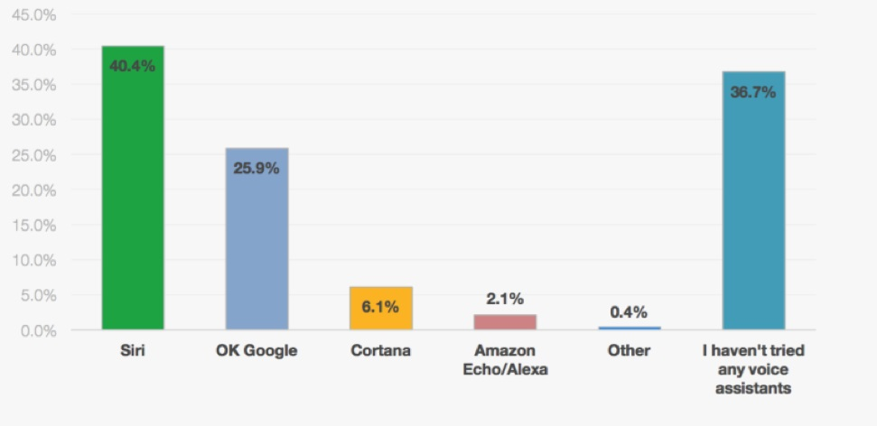
Why Choose Virtual Assistant as a project?

Slide 4
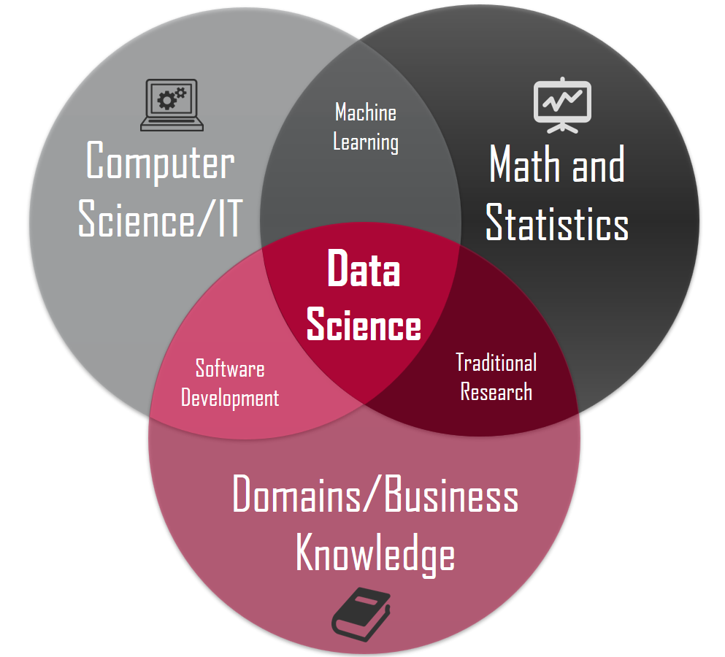

Slide 5
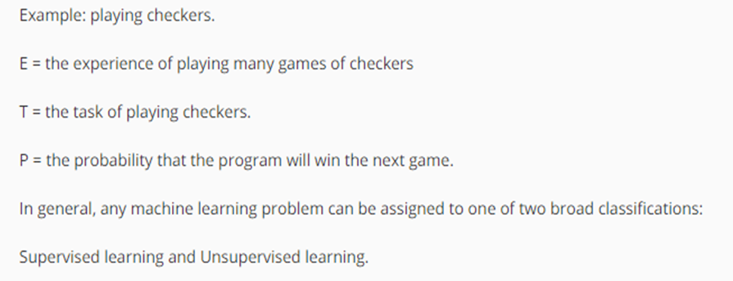
What is Machine Learning ?

Slide 6
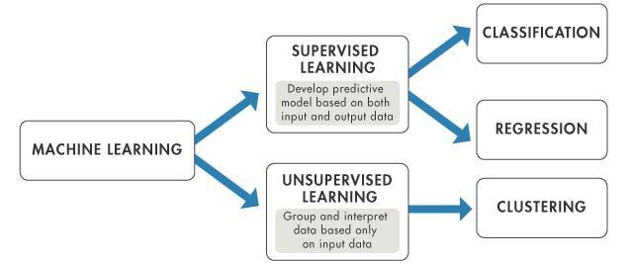

Slide 7
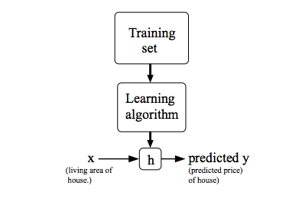

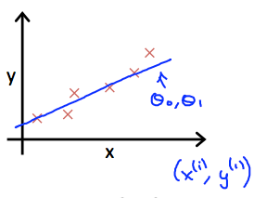

Cost Function

Slide 8

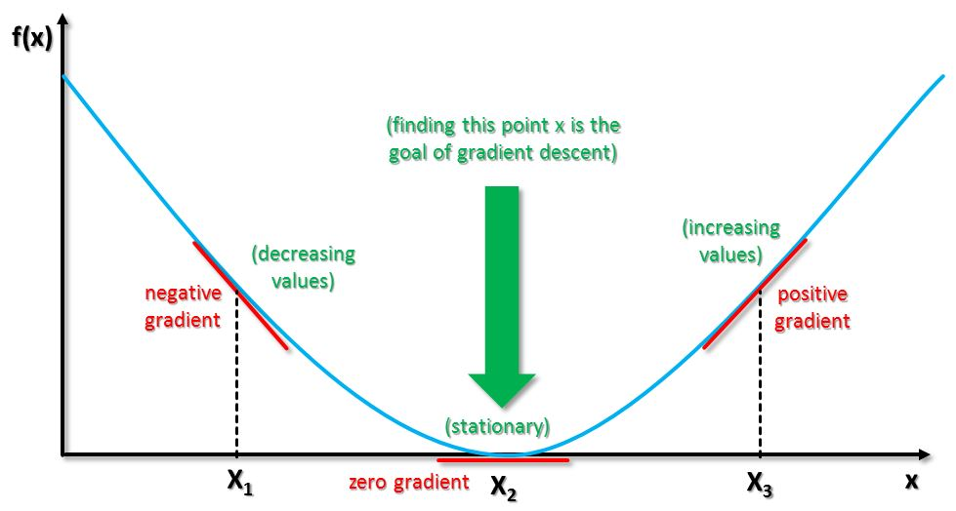
Gradient Descent

Slide 9
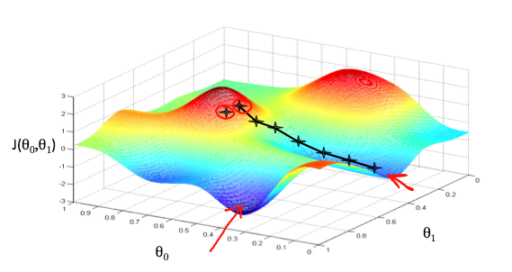
Gradient Descent

Slide 10
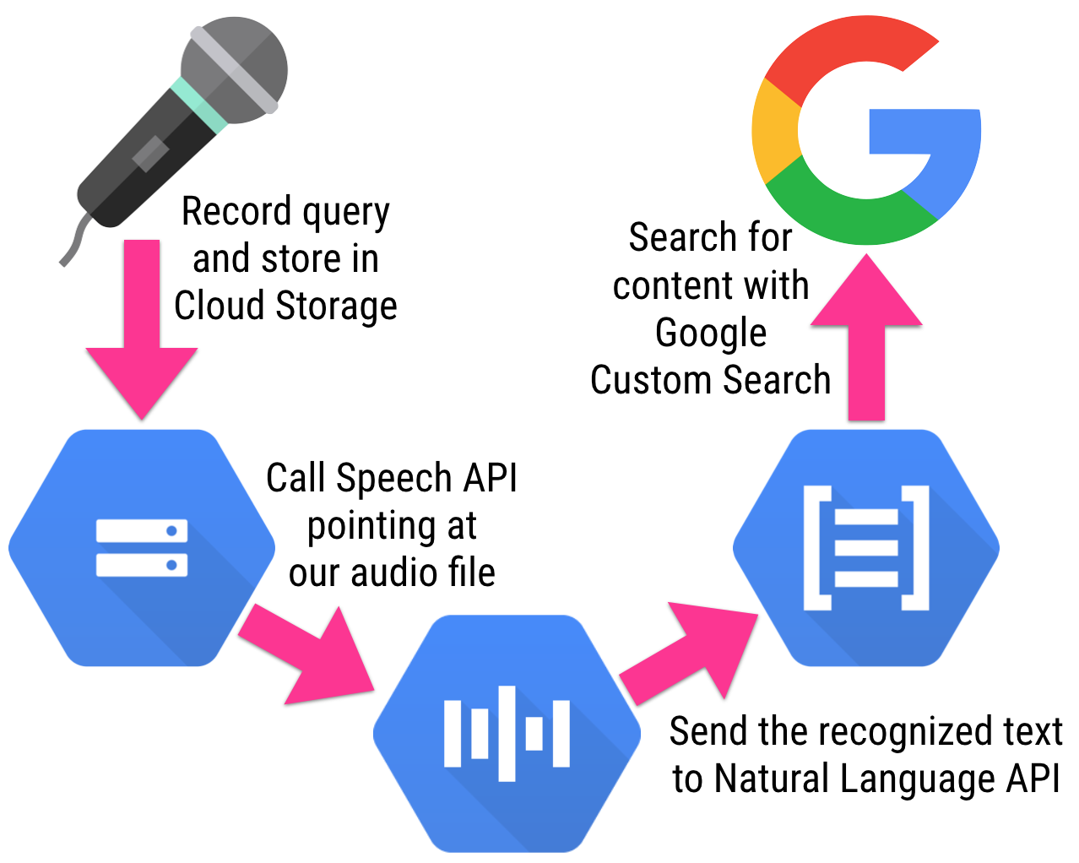

Slide 11
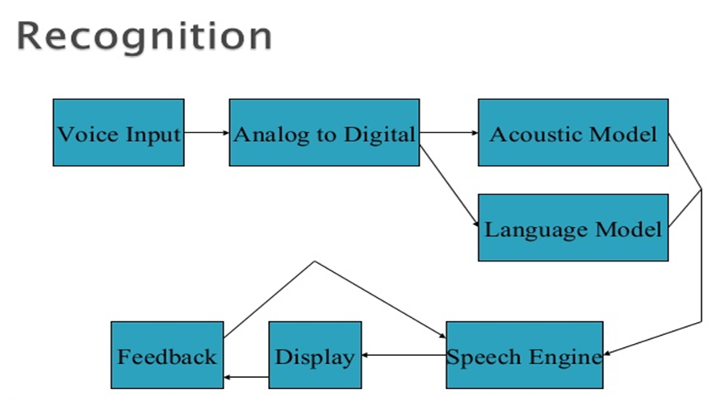

Slide 12
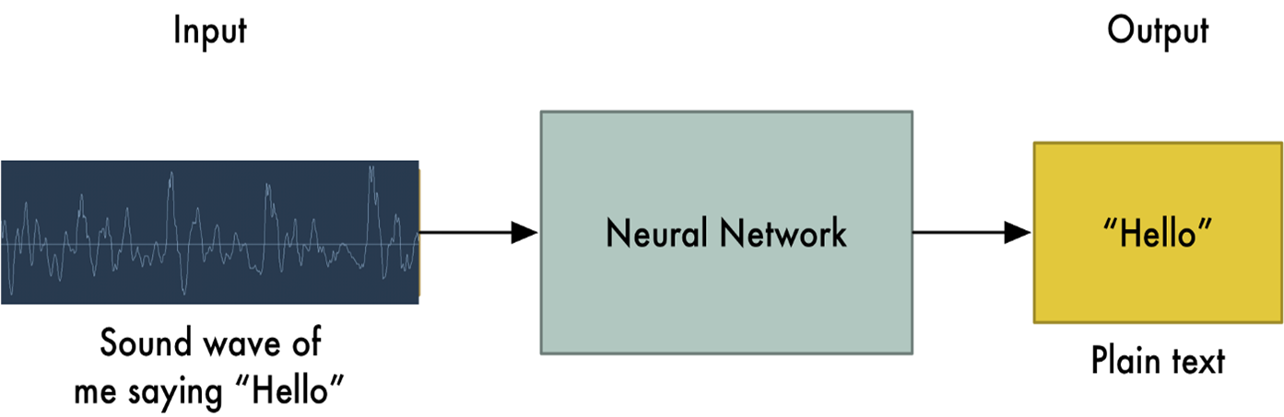
How to do Speech Recognition ?

Slide 13
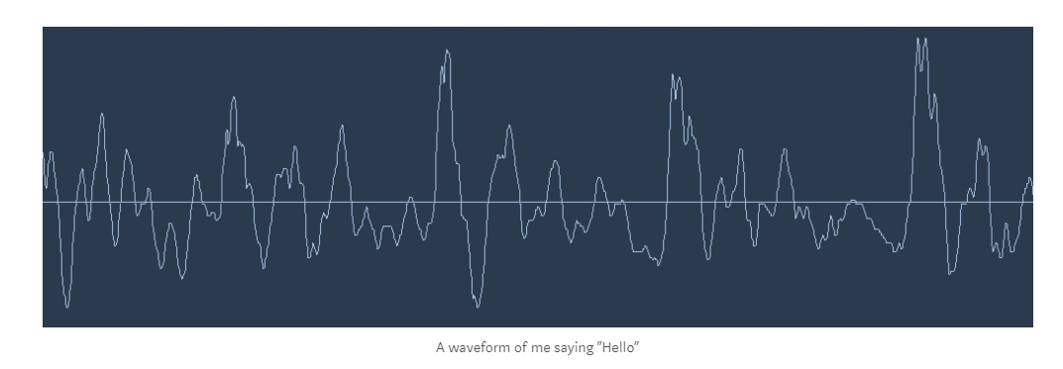
Sound is transmitted as waves. How do we turn sound waves into numbers? Let’s use this sound clip of me saying “Hello”

Slide 14
“CD Quality” audio is sampled at 44.1khz (44,100 readings per second). But for speech recognition, a sampling rate of 16khz (16,000 samples per second)

Slide 15
Lets sample our “Hello” sound wave 16,000 times per second. Here’s the first 100 samples:

Slide 16
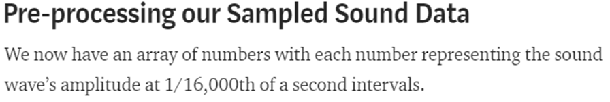

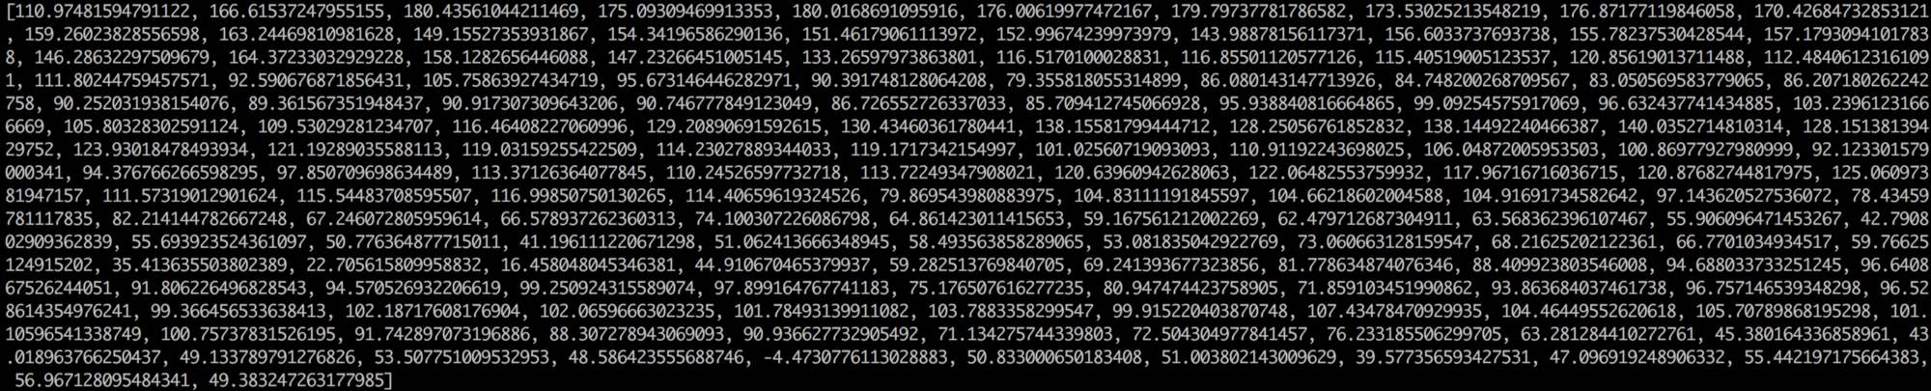

Slide 17
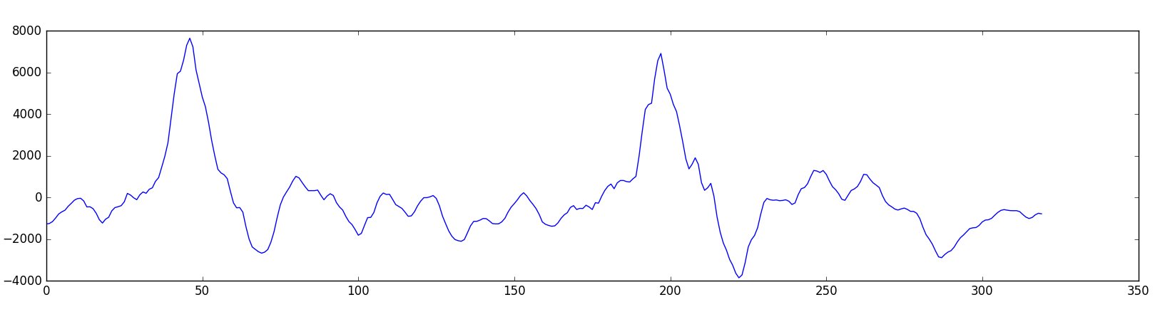
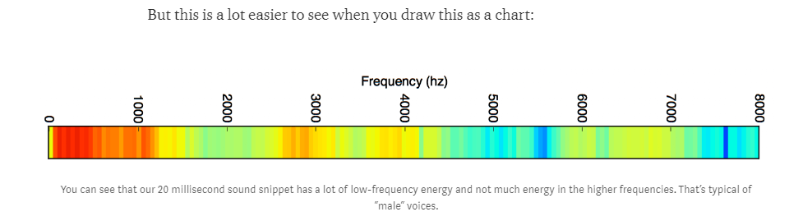

Slide 18
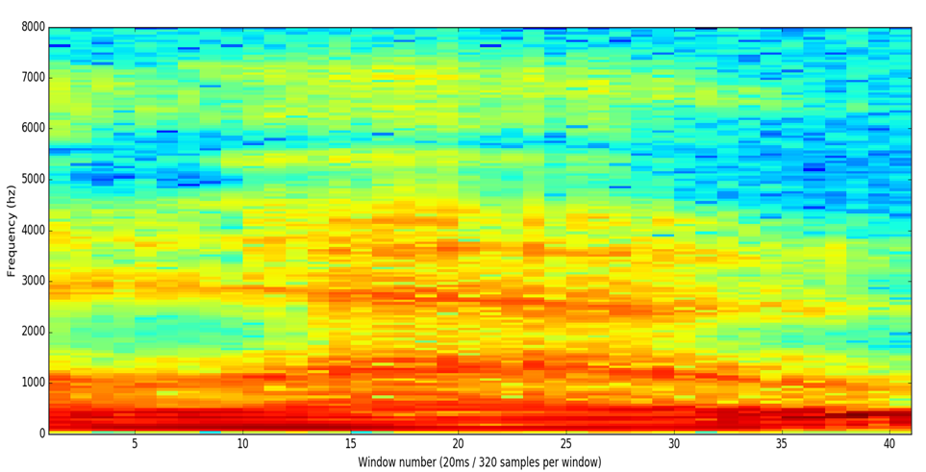
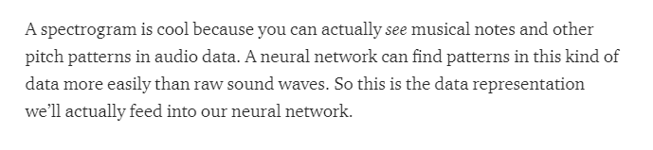

Slide 19
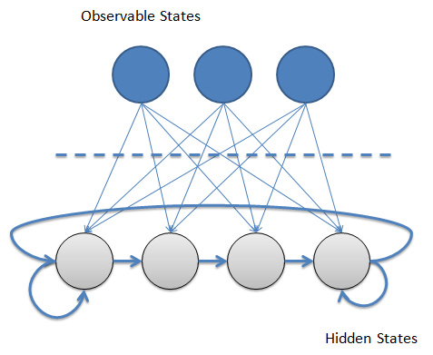
Hidden Markov Model

Slide 20


